Slide 1
Deep Logical Circuits
Generalization through Interpretation

Slide 2
Contribution:
Algorithm:
Neural Network -> Boolean Formula
<->linear decision tree
Allows:
Very tight gen bounds
& Interpretability
Should answer together:
“Did it learn?”
“What did it learn?”

Slide 3
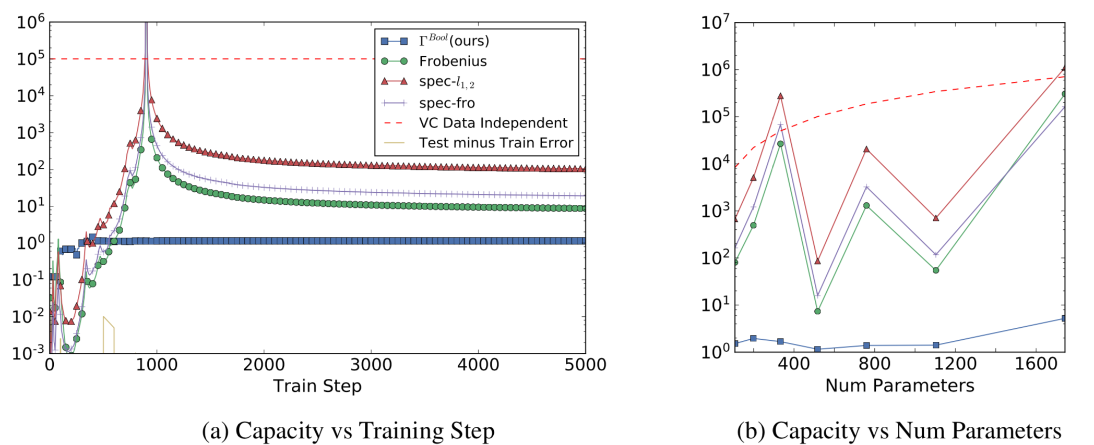
Spoilers

Slide 4
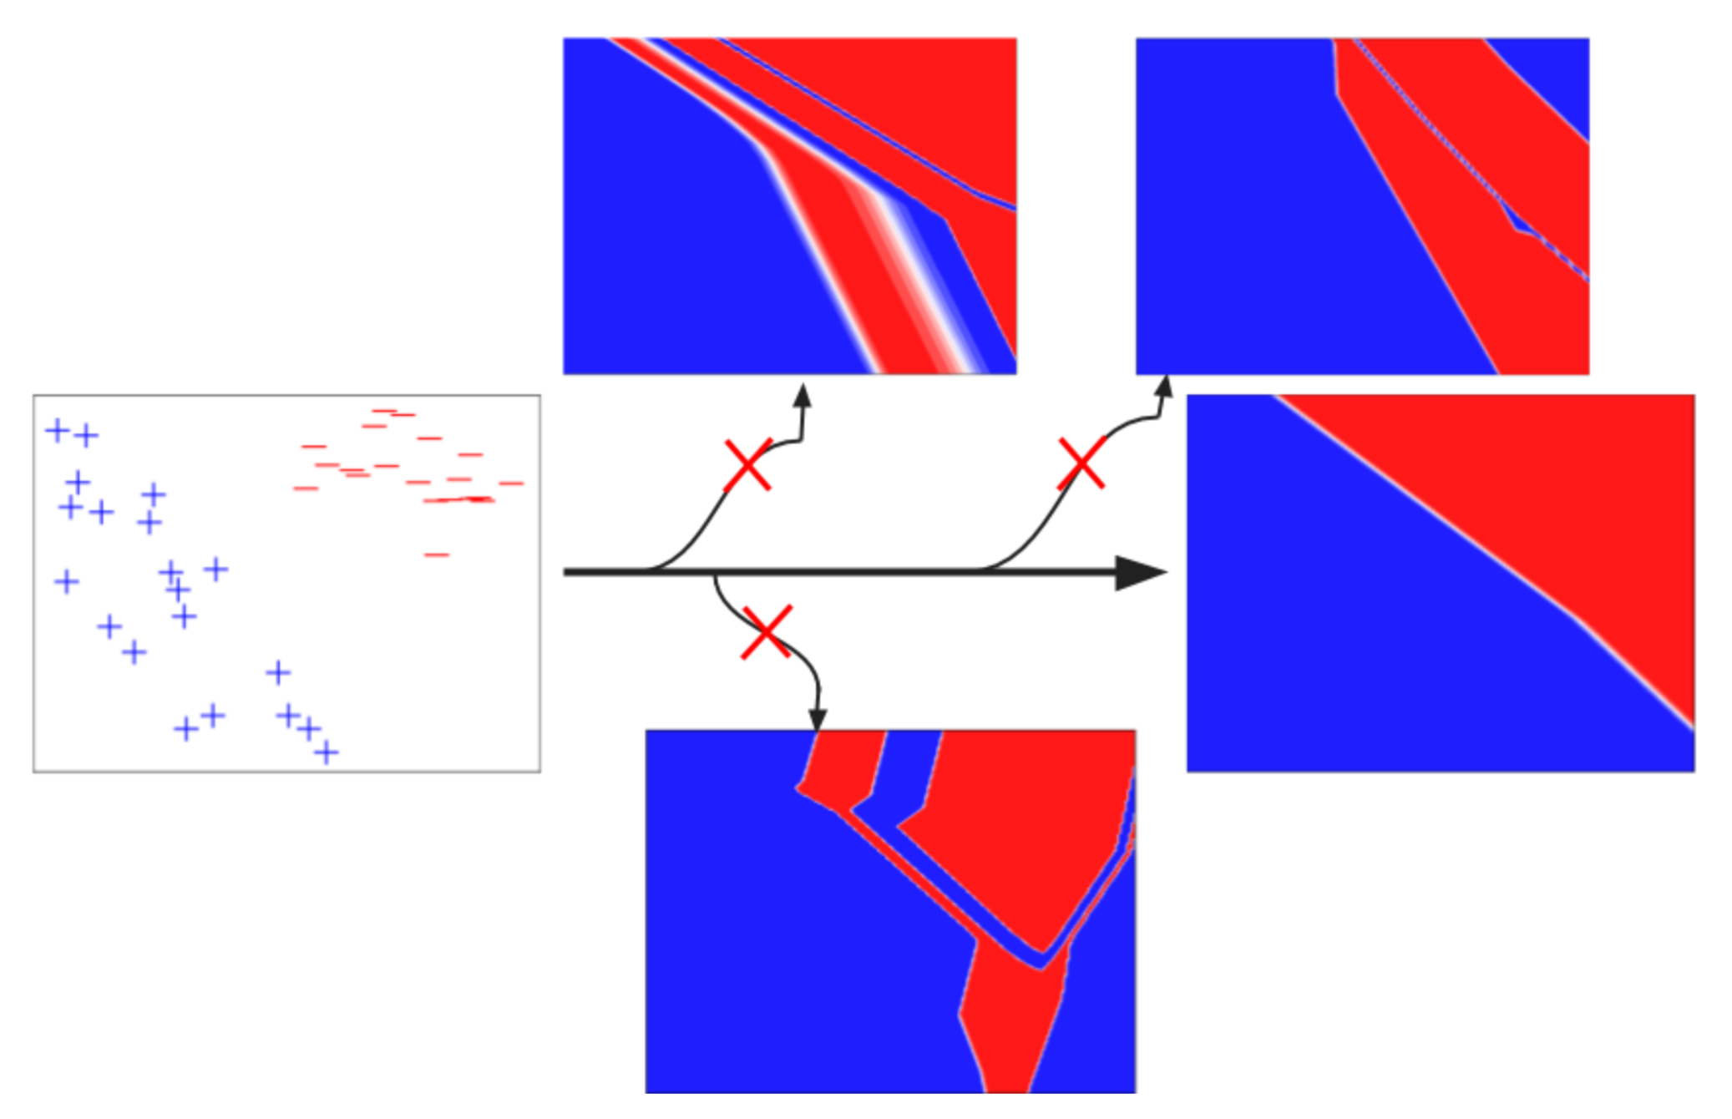
Linear Data : “Why does deep learning work”

Slide 5
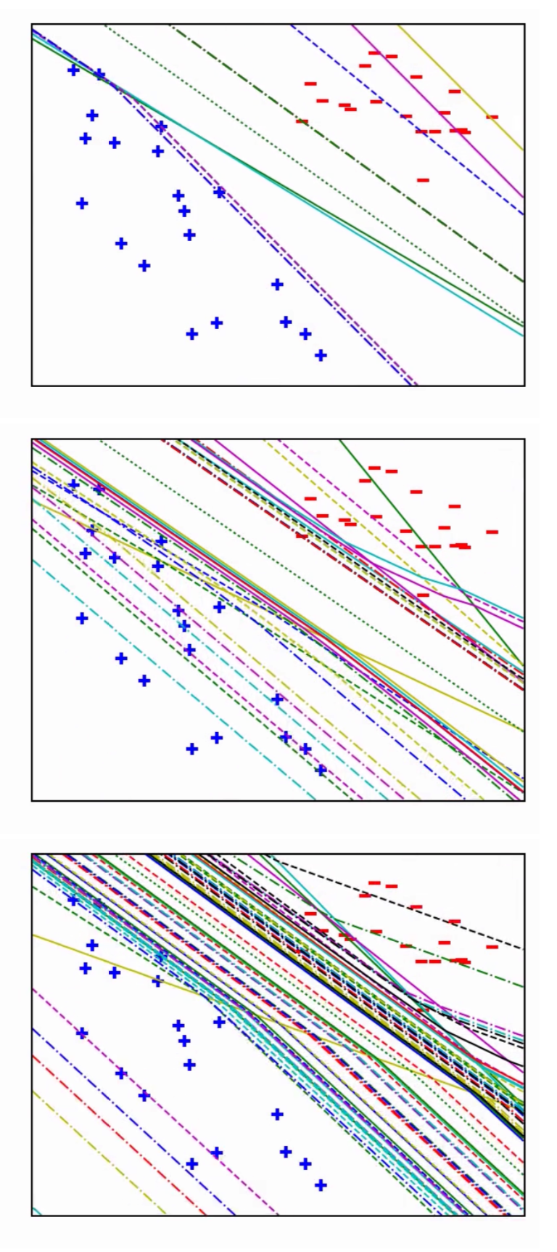
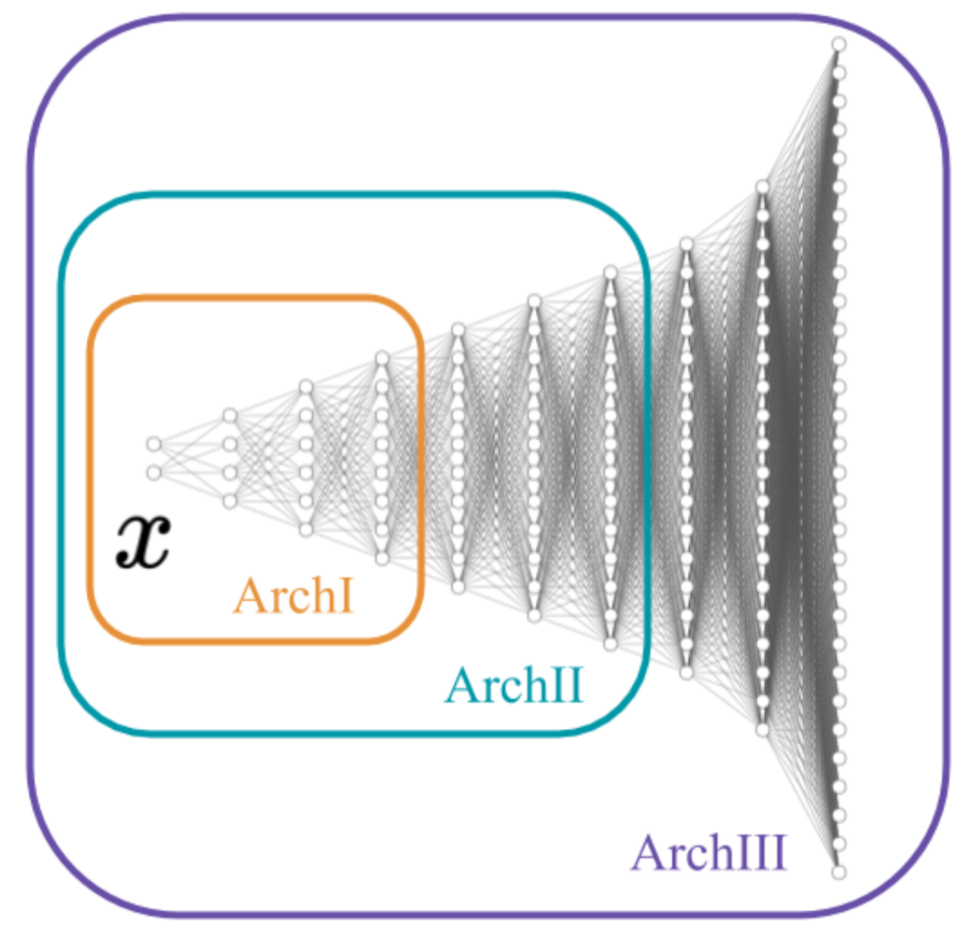
Looking closer: Neuron by Neuron
+
=
Regularity even has combinatorial description

Slide 6
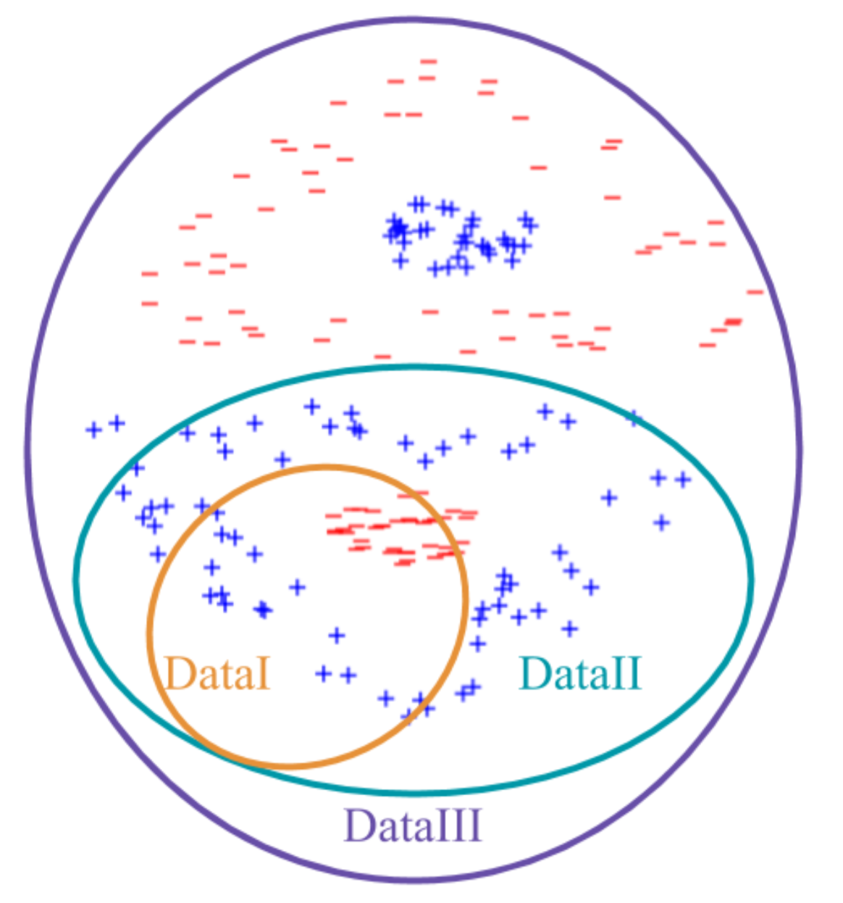
More complicated data

Slide 7
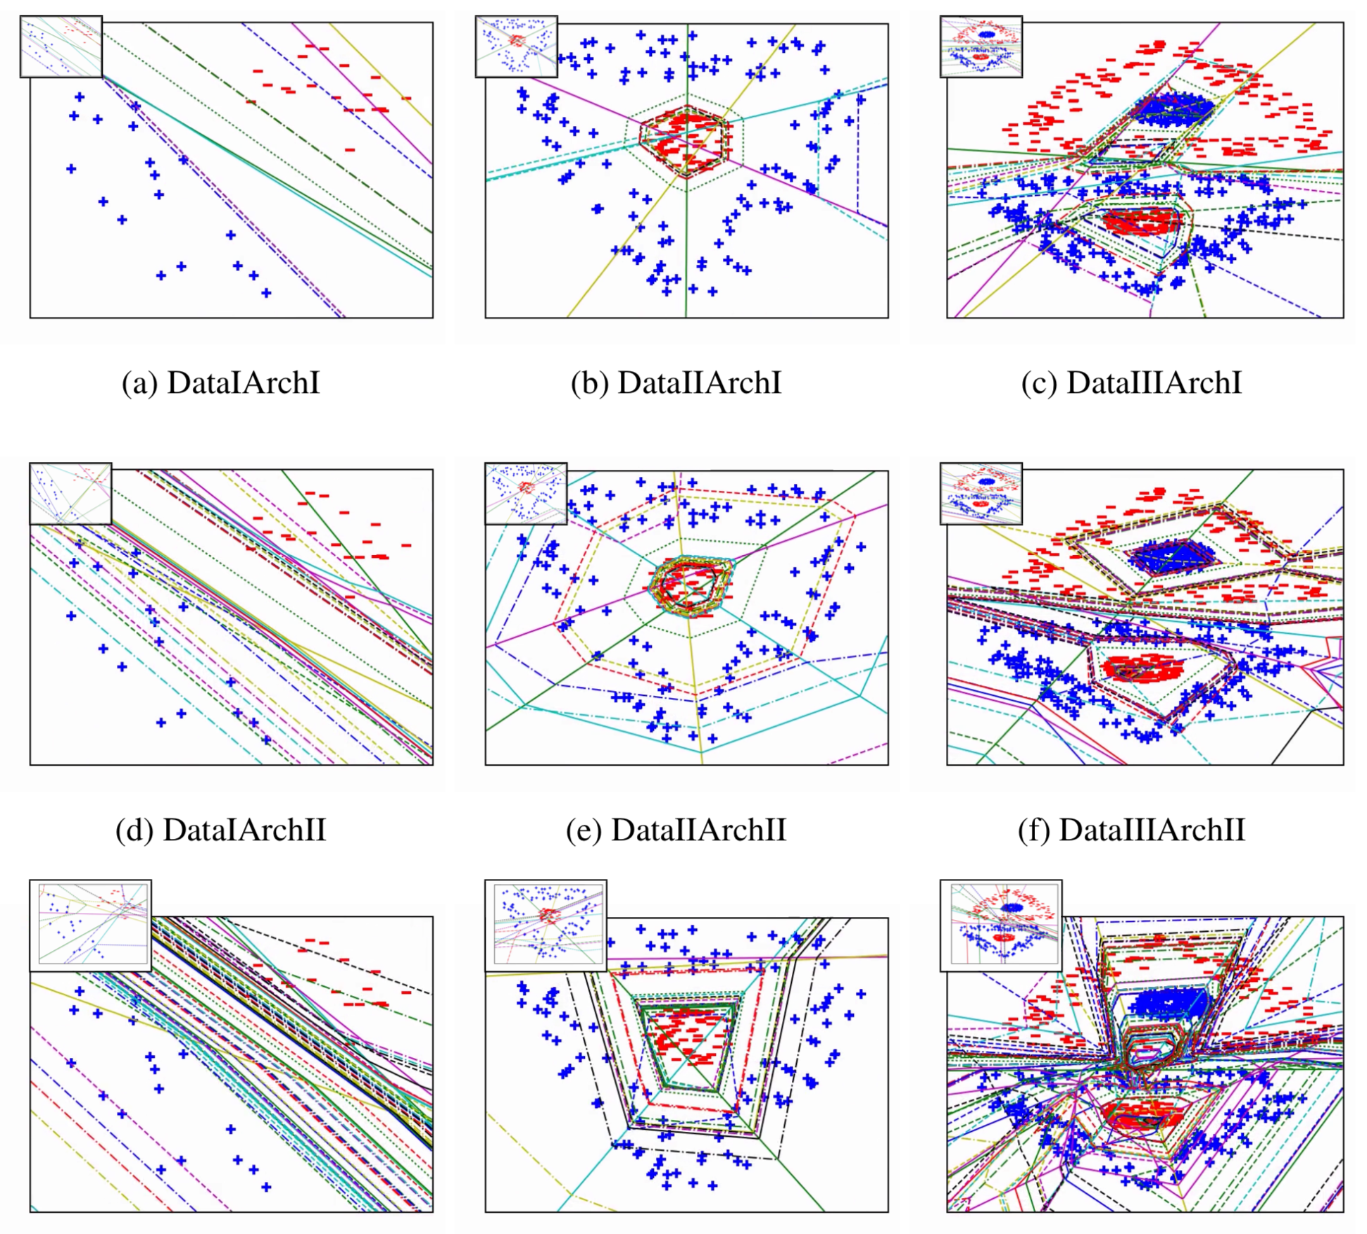
More complicated data -> Similar Conclusion

Slide 8
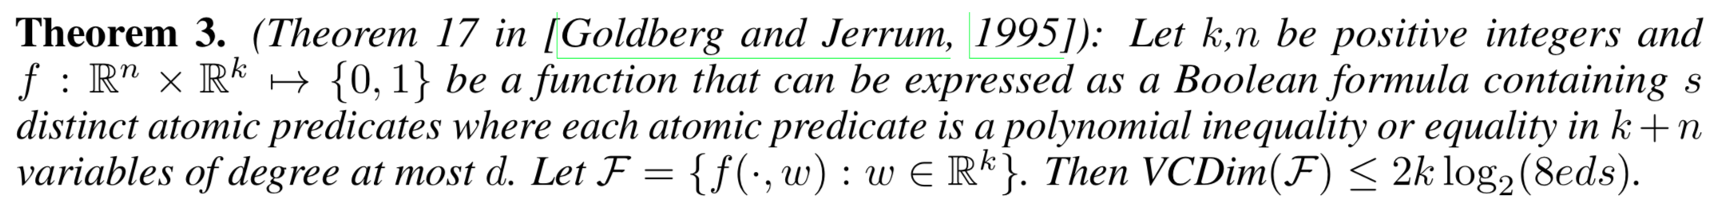
How to Analyze Nonlinear Case
-> Need to express network as boolean formula
(Complexity doesn’t depend on depth)

Slide 9
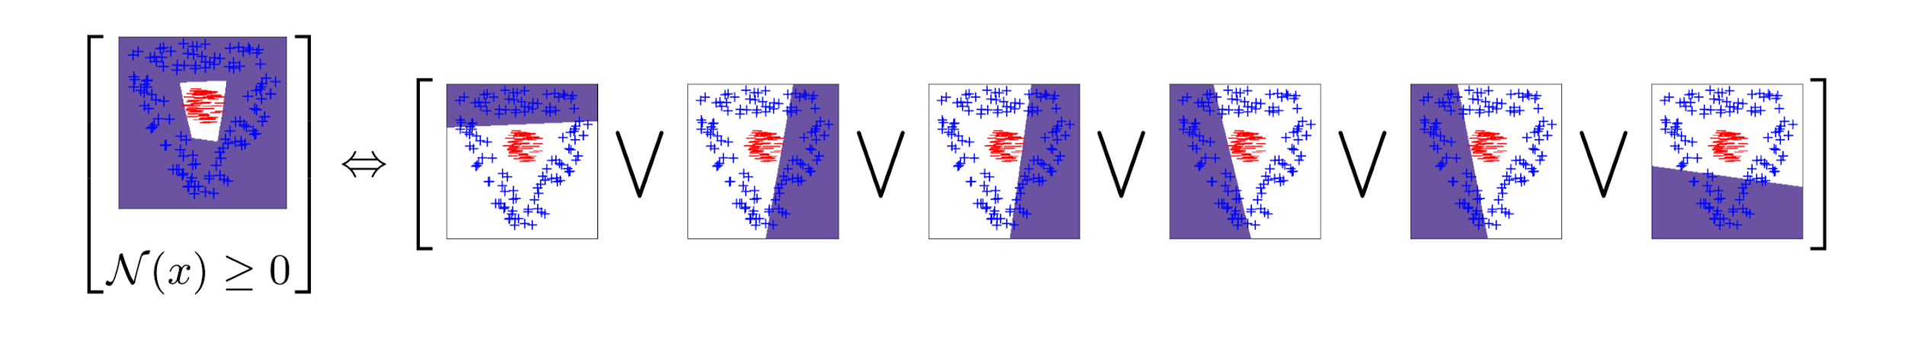
How to Analyze Nonlinear Case
-> Need to express network as boolean formula
(Complexity doesn’t depend on depth)
Example of transformation Output (7e5 param)

Slide 11
Setting
Fully connected networks -> control network complexity

Slide 12
Setting
Fully connected networks -> control network complexity
Synthetic Data -> Control data complexity

